Slide 1
Tutorial: Film Dosimetry Analysis
Csaba Pinter
Laboratory for Percutaneous Surgery, Queen’s University, Kingston, ON, Canada

Slide 2
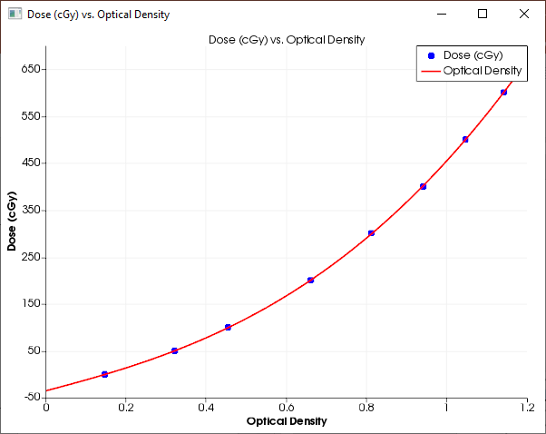
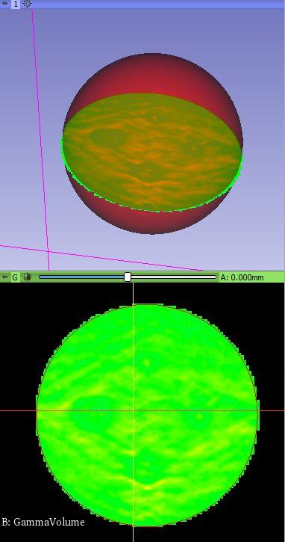
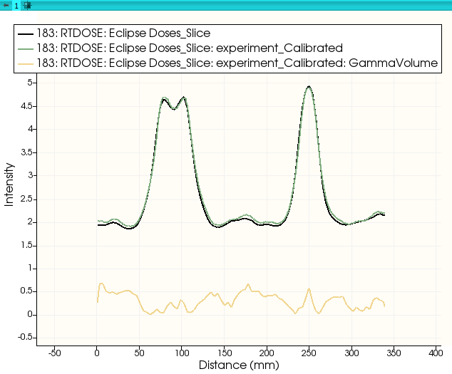
Learning objective
This tutorial demonstrates how to perform a film dosimetry analysis with the streamlined “slicelet” in 3D Slicer.

Slide 3
Overview
Install required software
Download test data
Perform calibration
Evaluate calibration

Slide 4
1/1. Install 3D Slicer
Download 3D Slicer preview from https://download.slicer.org/
Find the downloaded 3D Slicer package on your computer
Follow the usual steps to install an application
Different for each operating system

Slide 5
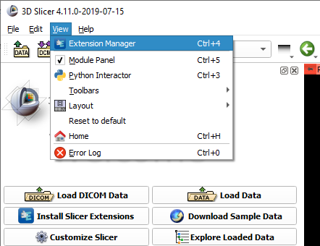

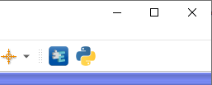
1/2. Install SlicerRT extension
or

Slide 6
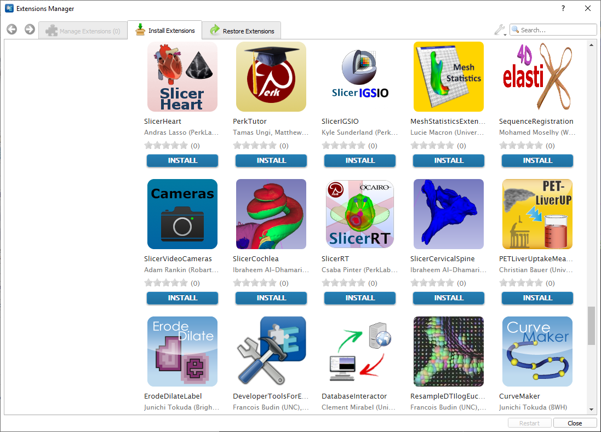
1/3. Install SlicerRT extension

Slide 7
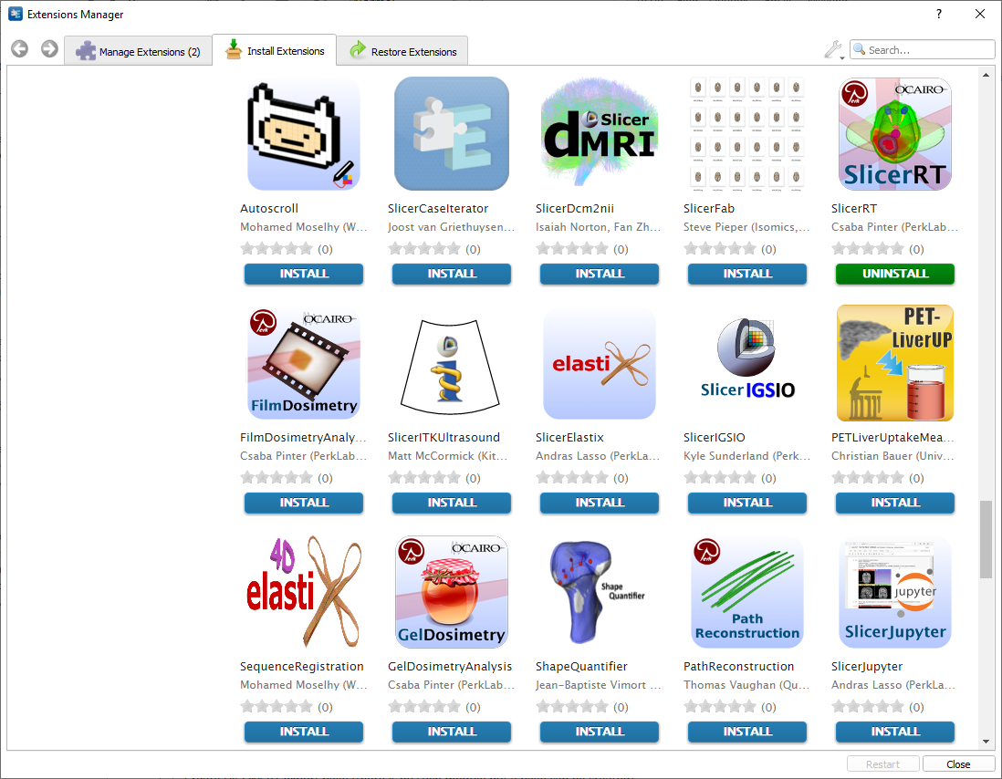
1/4. Install FilmDosimetryAnalysis extension

Slide 8
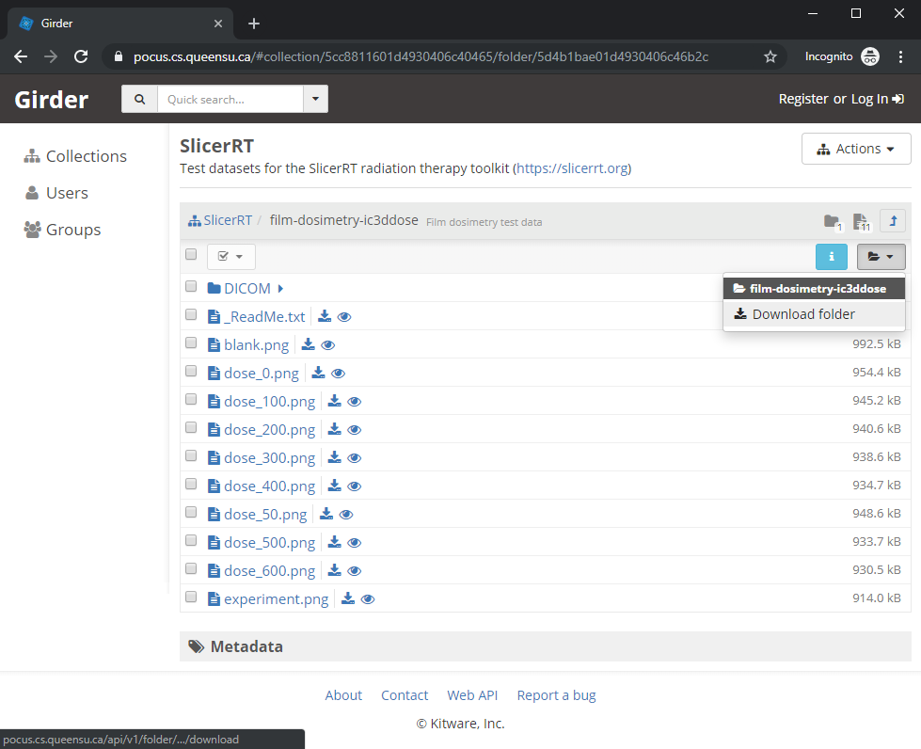
2/1. Download test data
Open in browser: https://pocus.cs.queensu.ca/#collection/5cc8811601d4930406c40465/folder/5d4b1bae01d4930406c46b2c

Slide 9
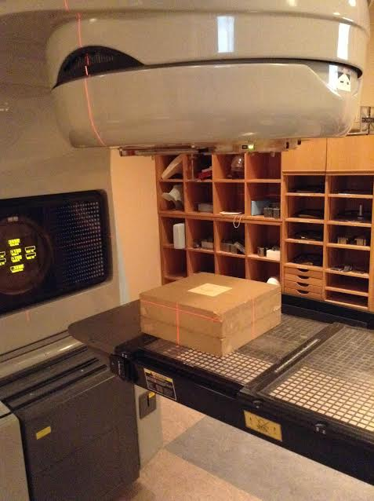
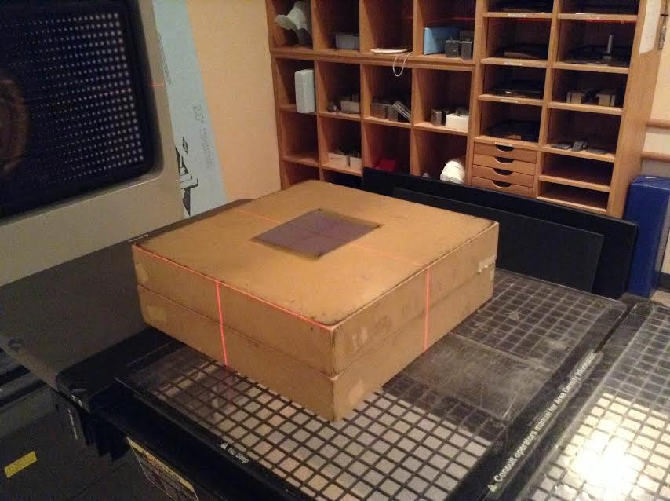
2/2. Where did this data come from?
Calibration films were irradiated in well characterized radiation fields (10x10 cm² at d_{max}) to a range of doses

Slide 10
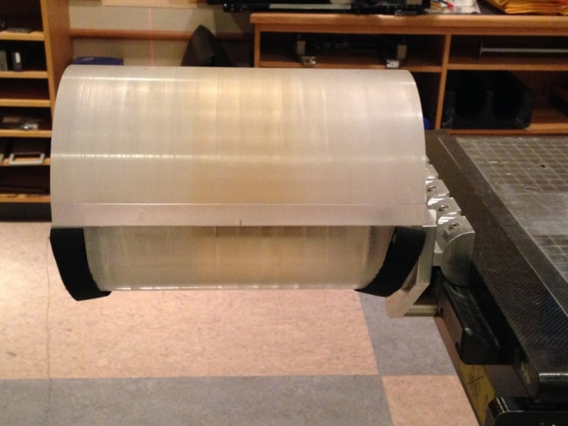
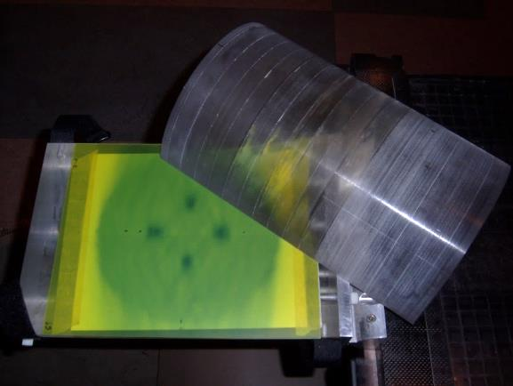
2/3. Where did this data come from?
Treatment planning using Eclipse:
Dual arc delivery FSRT VMAT (4 Gy delivered to mets, plus 2 Gy SIB)
Delivery to a cylindrical phantom with film at isocenter plane
Outputs: Planning dose volume, Structures

Slide 11
2/4. Where did this data come from?
Irradiation day:
Quarter sheets of Gafchromic EBT3 film used for calibration points
Full sheet irradiation for experimental/measured film (FSRT VMAT irradiation)

Slide 12
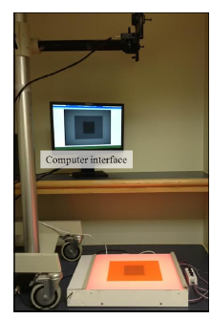
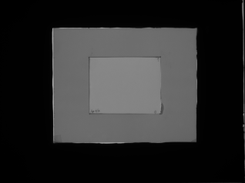
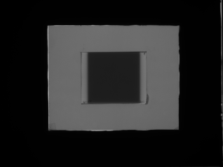
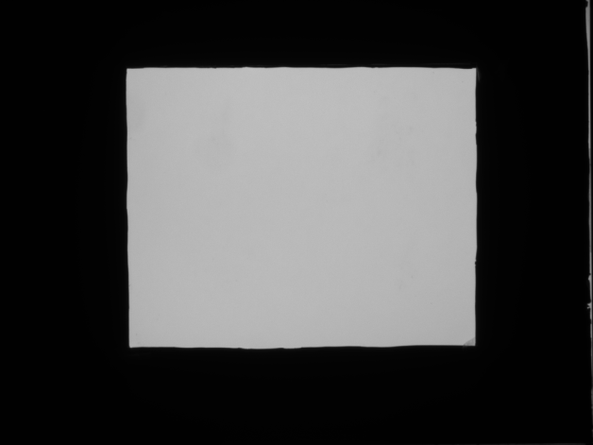
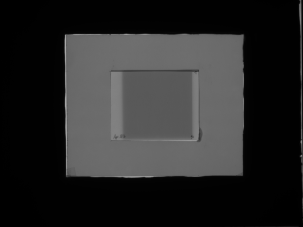
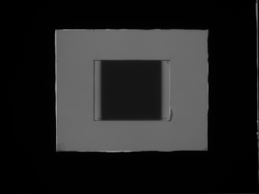
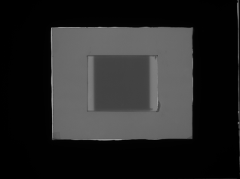
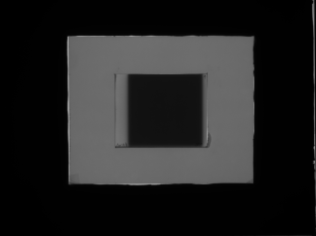
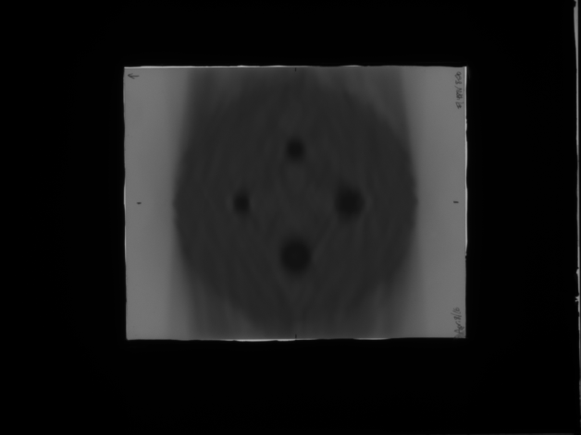
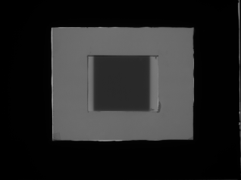

2/5. Where did this data come from?
Film imaged 24 hrs post-irr.
CCSEO Film Imager
Calibration Set
0 cGy
300 cGy
Empty Light Field
50 cGy
400 cGy
100 cGy
500 cGy
FSRT VMAT Delivery
200 cGy
600 cGy

Slide 13
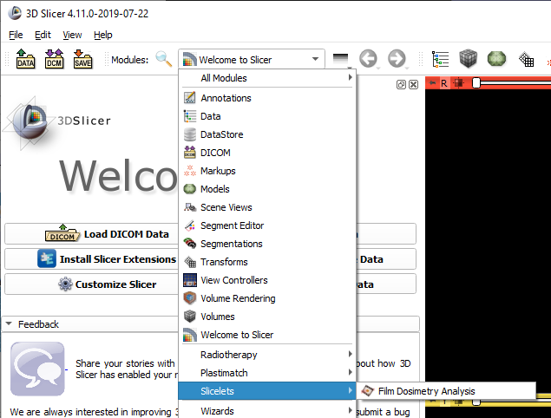
3/1. Open Film Dosimetry slicelet
Once in the ‘Film Dosimetry Analysis’ module, click ‘Show slicelet’

Slide 14
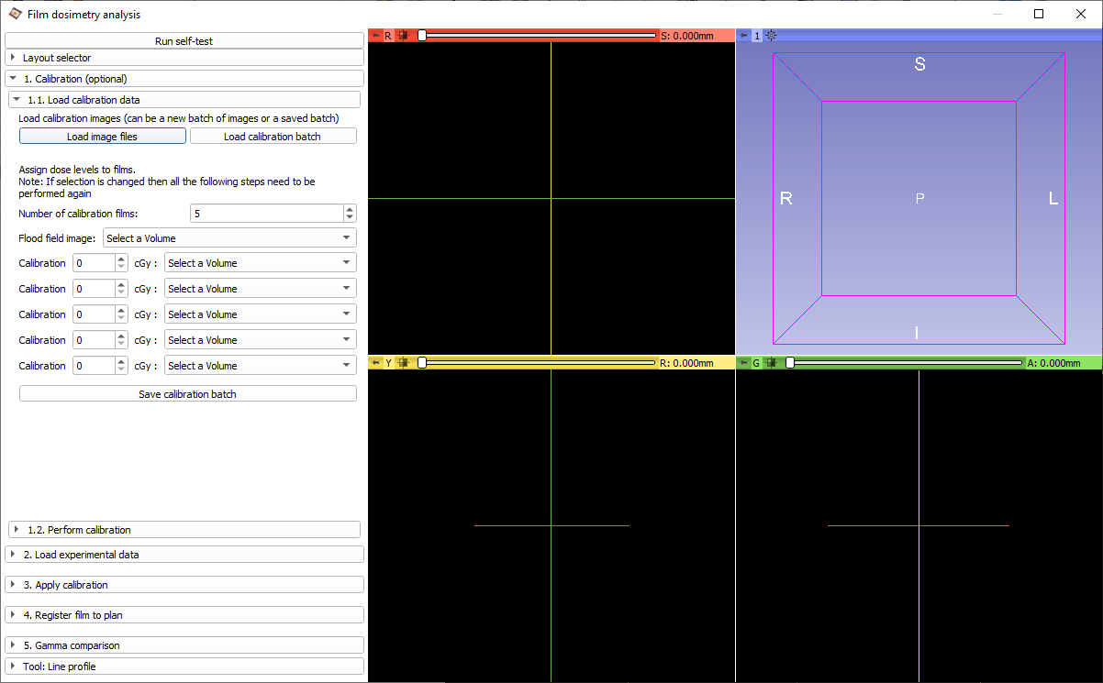
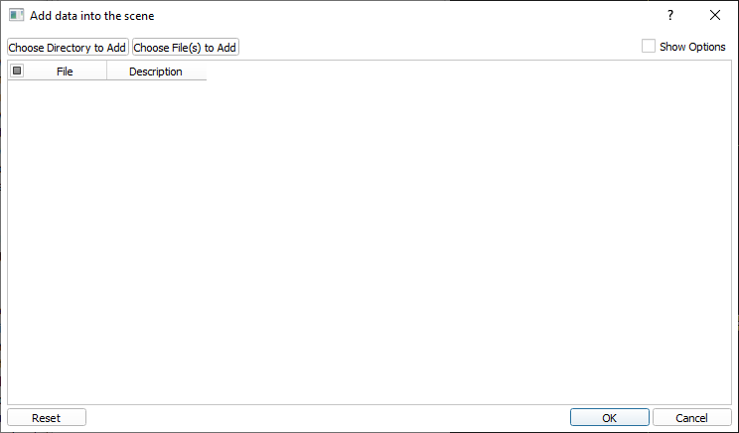
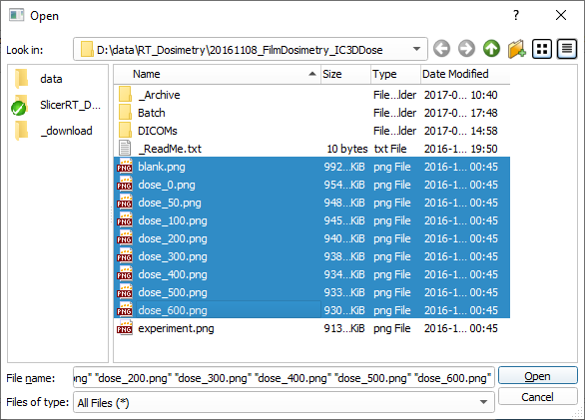
3/2. Load film images

Slide 15
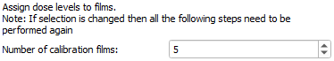
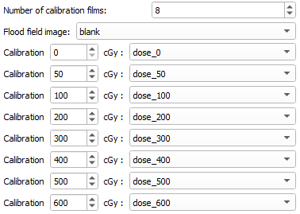
3/3. Assign dose levels to films

Slide 16
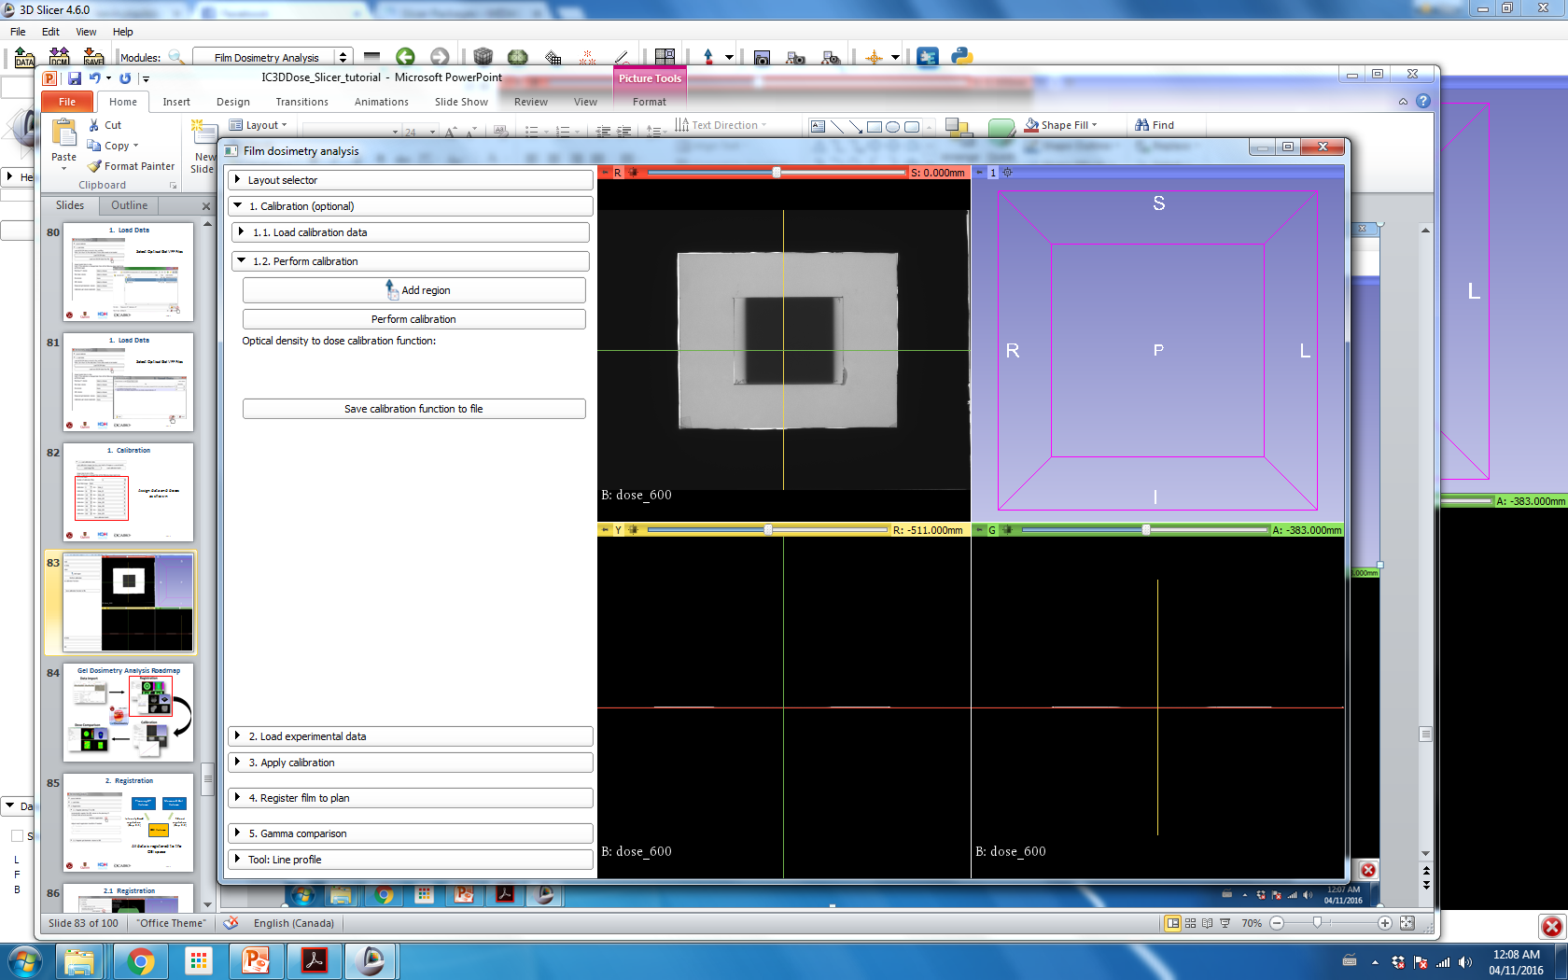
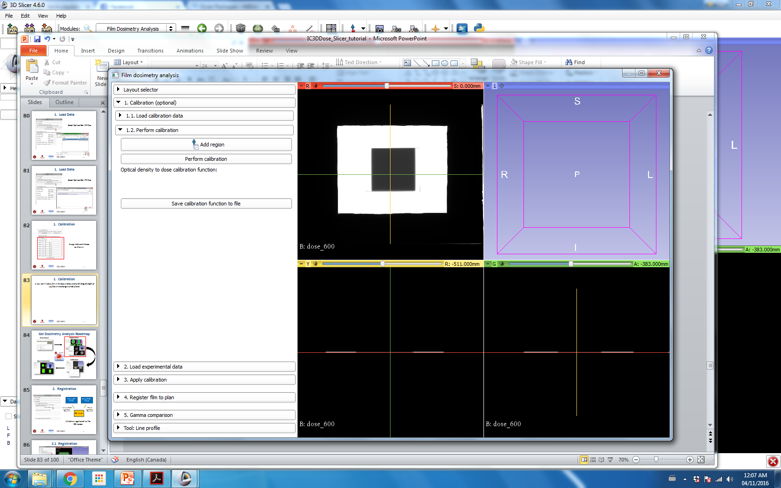
3/4. Define calibration region
Click Add region, then click in the center of the film then to the region corner to define a region of interest (ROI).

Slide 17
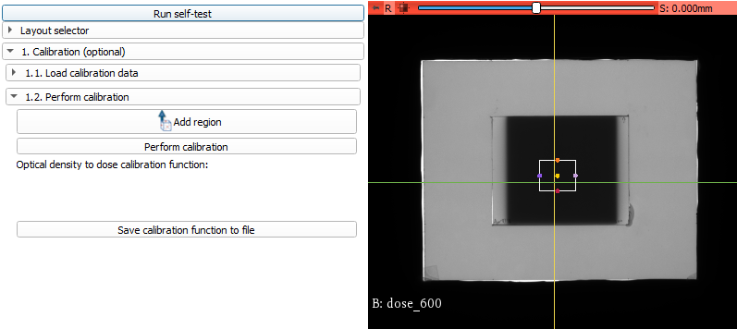
3/5. Run calibration

Slide 18
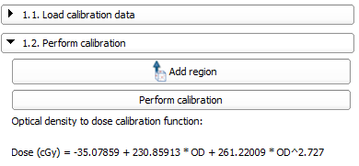
3/6. Calibration ready
Calibration function has been determined, of the form:
Dose = a + bOD + cOD^{n}

Slide 19
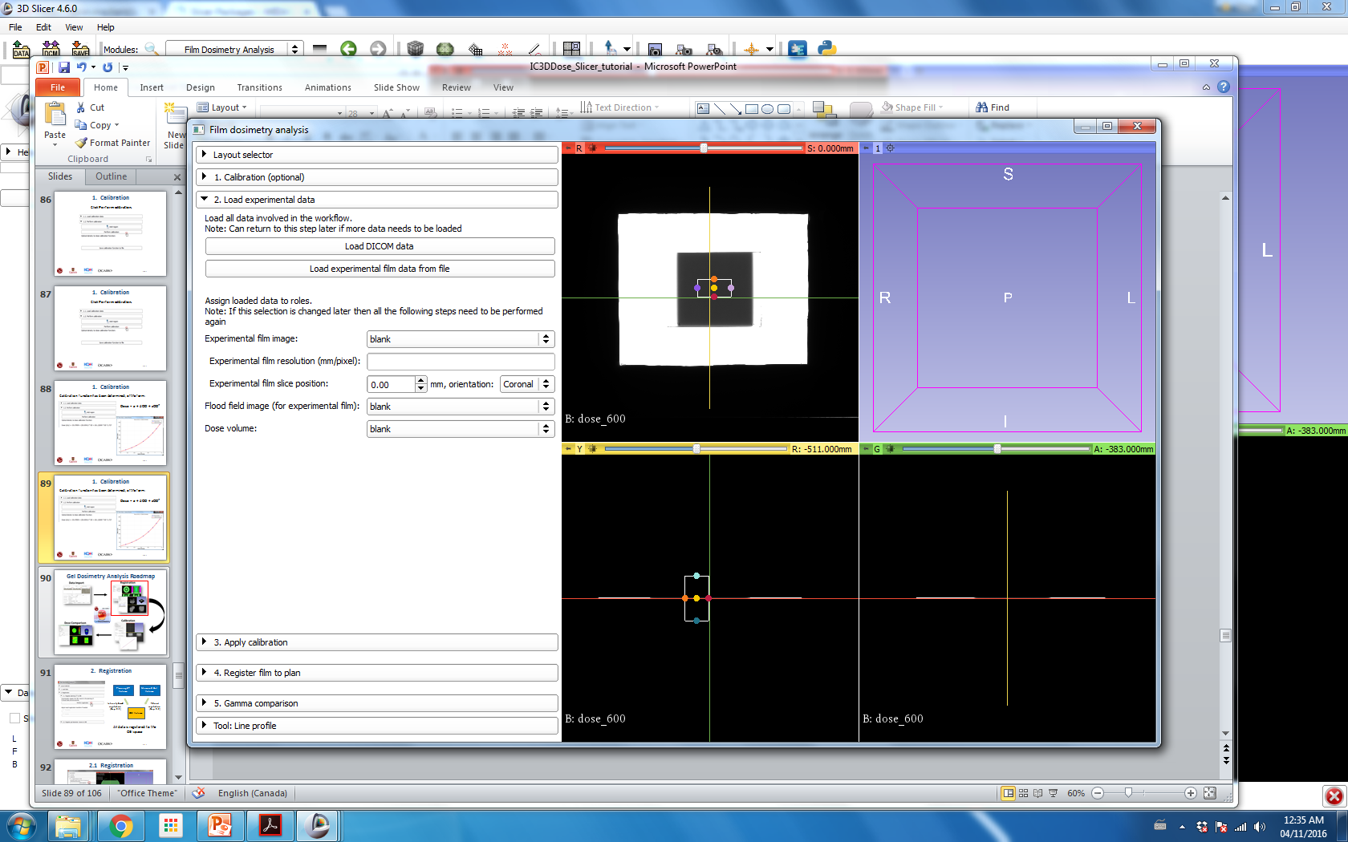
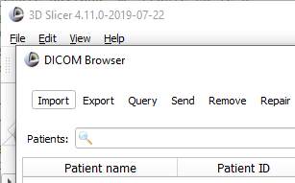
3/7. Load experimental DICOM data
Select Film Dosimetry Dataset folder.
Then select the DICOM folder and click ‘Import’.
Then, when prompted click Add link.

Slide 20
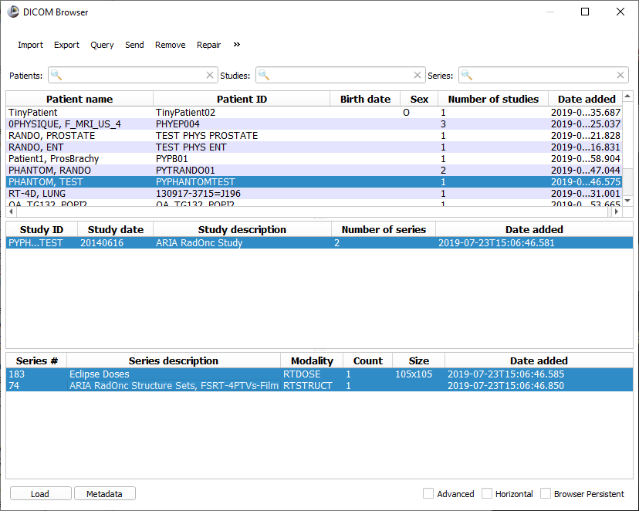
3/8. Load experimental DICOM data

Slide 21
3/8. Load experimental film
Select Film Dosimetry Dataset folder that was just downloaded.
Then select the Images folder. Select the experimental.png file and click ‘Open’

Slide 22
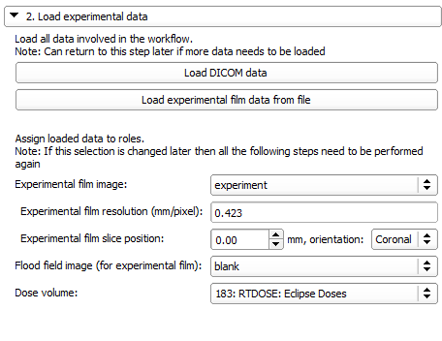
3/9. Set experiment properties
Assign data as shown
Film resolution (mm/px) = 0.423
Define film plane and axis to be exported from DICOM dose distribution

Slide 23
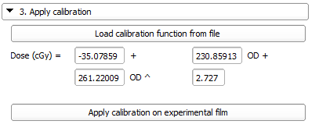
3/10. Apply calibration
Apply calibration to convert film from optical density to dose
Note: Calibration function can be imported from a previously saved file, or can be input manually in this step.

Slide 24
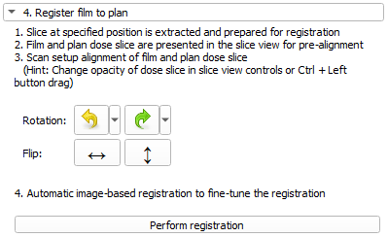
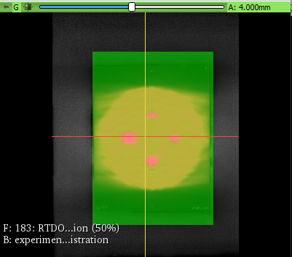
4/1. Register film to plan
1. Pre-align film with the rotation and flip buttons
2. Click Perform registration to perform an intensity based registration between film and Eclipse dose plane
Grayscale: Calibrated film measurement
Greenscale: Eclipse dose plane

Slide 25
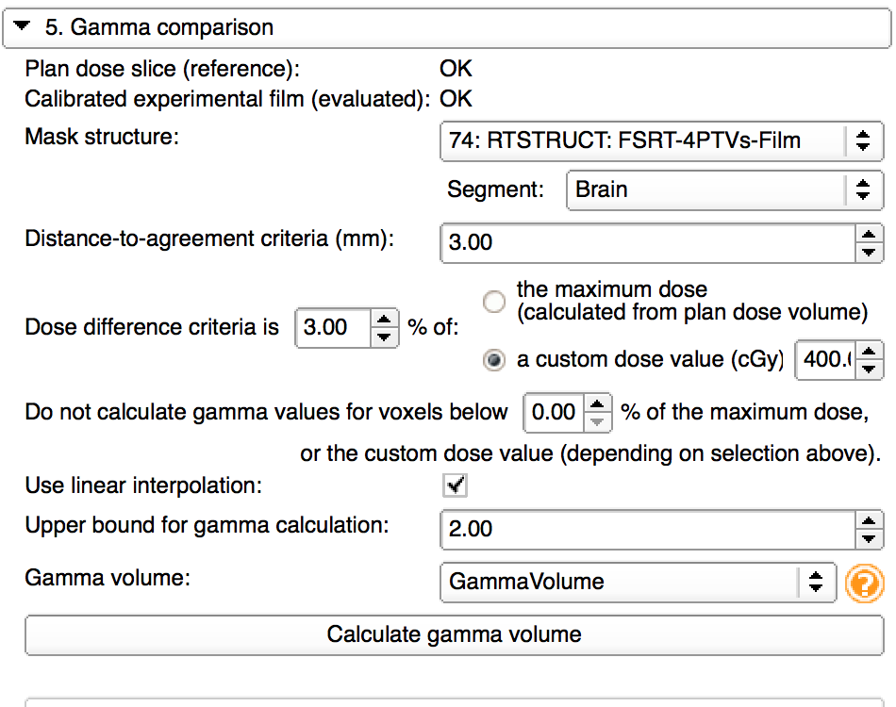
4/2. Dose comparison
Dose maps are automatically assigned
Select 74: RTSTRUCT Structure set. Choose ‘Brain’ structure.
Set dose value to 400 cGy (prescription)
Set dose threshold to 0%
Create new gamma volume

Slide 26
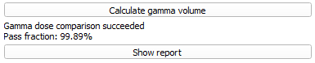
4/3. Gamma comparison done

Slide 27
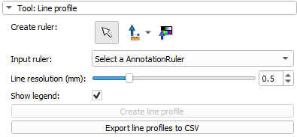
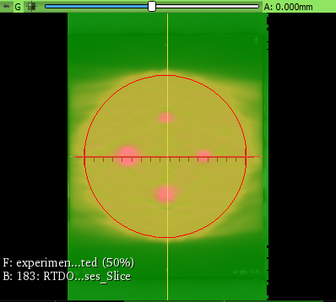
4/4. Line profile

Slide 28

Congratulations!

